Slide 1
A Case Study in Linear and Logistic Regression
Presented by:
Denise Lee, Max Riching & Ali Taheri
UOP ANLT-272 Spring 2018

Slide 2
Objective
The objective was to use paid healthcare claims data to make two models:
Linear regression to predict total post index costs for patients using anticoagulant and antidiabetic drugs
Logistic regression model to predict drug adherence for patients using antidiabetic drugs
Predicting post index healthcare costs & patient drug adherence

Slide 3
Data Set and Data Exploration
LifeLink Health Plan Claims Database
Claims, Enrollee and National Drug Code datasets were merged and was filtered to identify and extract all patients that had claims for drug classes of interest
Potential Model Features
Demographic data
Age, gender, geographic region
Indications for comorbidity diagnoses
Pre- and post-index claims indicating
Hospitalization
ER visits
Healthcare expenditures for outpatient services

Slide 4
Statistical Analysis of Variables
Binary/Categorical Variables
Variables of Interest
Chi-squared testing
Levene Test for equal variance
T-test
ANOVA
Linear Model
Post Index Total Costs
Variable Name: post_total_cost
Logistic Model
Patient Drug Adherence
Variable Name: pdc_80_flag
Continuous Variables
Mainly applied to linear regression
Used a combination of the lm() function in R paired with backward/forward stepwise
Parameters were selected at a 99% confidence level

Slide 5
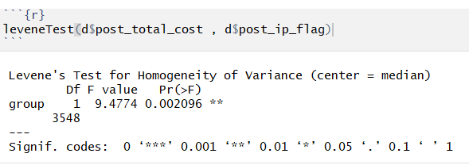
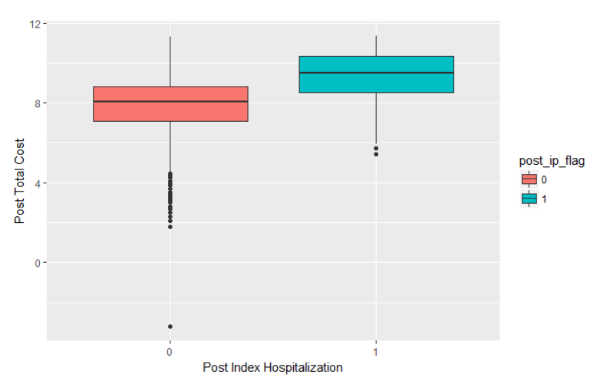
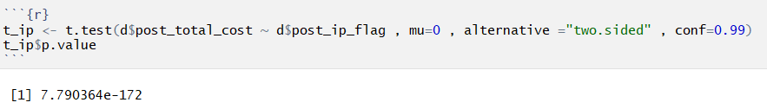
Significant Differences Between Groups
Example of Levene and T-test for post-index hospitalization

Slide 6
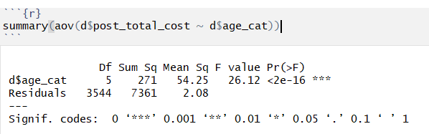
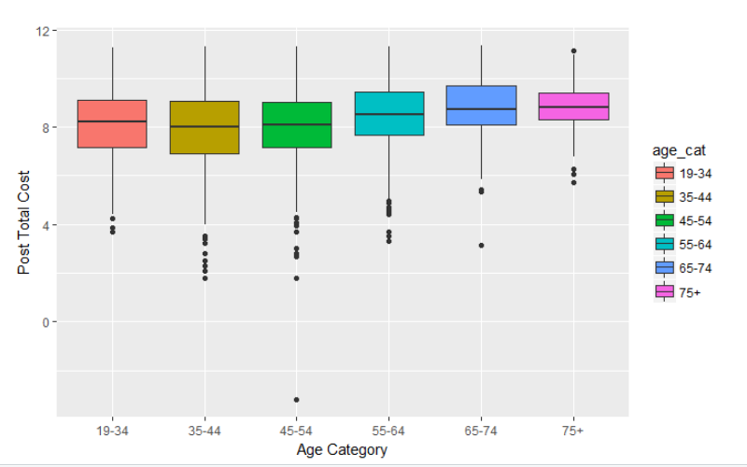
Significant Differences Between Groups
Example of ANOVA Testing for age category

Slide 7
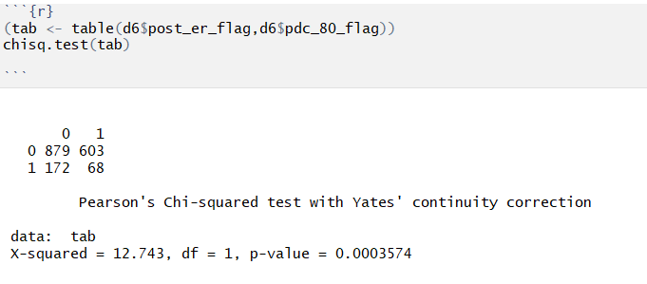
Significant Predictor Variables
Chi-squared Testing Example for post emergency visits

Slide 8
Linear Model
Model Selection and Visualization
Stepwise Regression
Forward and backward Reg.
Regression by Ridge
Regression by Lasso

Slide 9
Feature Selection:
Preparing categorical variables
Removing some independent variables with high multicollinearity same to ratio of two other columns
Using log of dependent variable for better Normality
Removing categorical values with high amount of p-value
Finding other continuous variables with multicollinearity
Dividing dataset to Training and Test sets (Role of thumb of 20%)

Slide 10
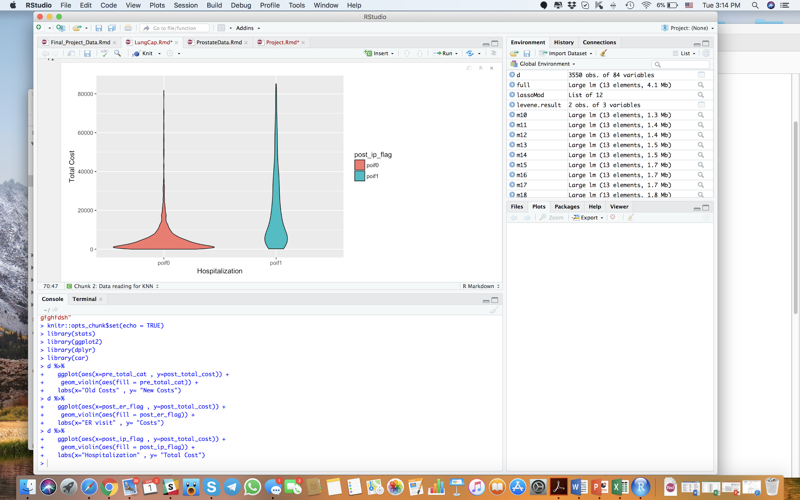

Violin Plots

Slide 11
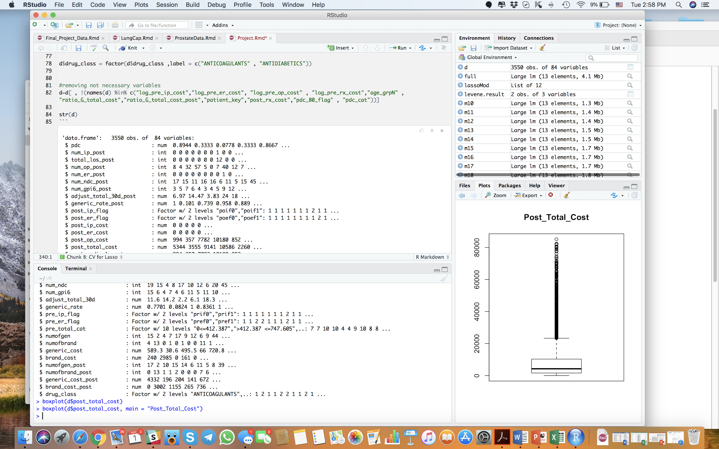
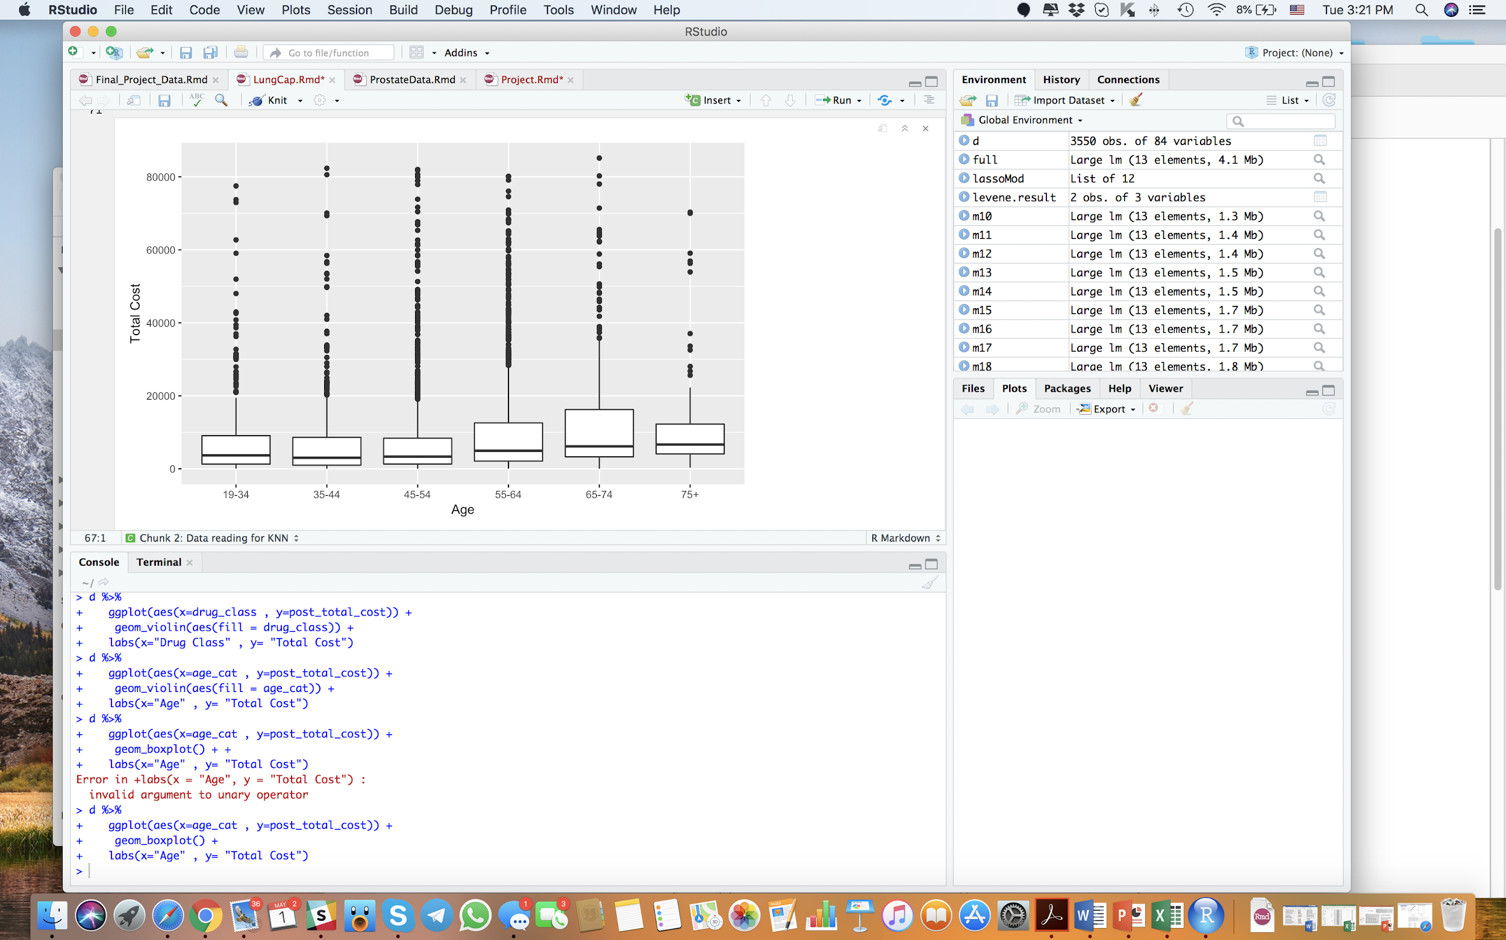
Box Plots

Slide 12
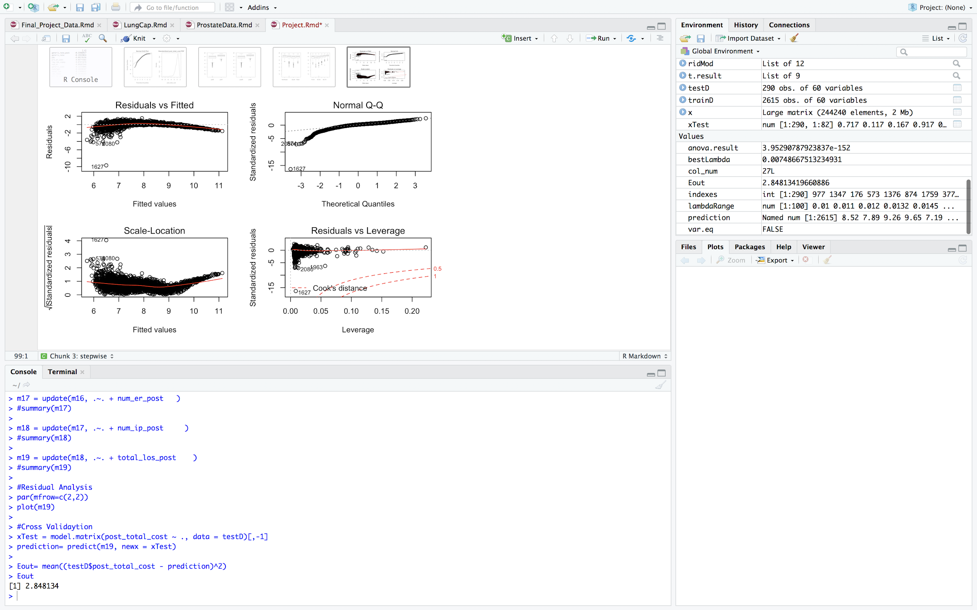
Stepwise Linear Regression
Selection of features with high amount of p-value
About 19 features have been selected
There is a deterministic pattern in our residuals that needs more activity to remove.
Out of sample error for this stepwise regression is 4.03 .
Out of sample error for forward method is 0.89 with 16 features.
Out of sample error for backward method is 0.86 with 14 features!

Slide 13
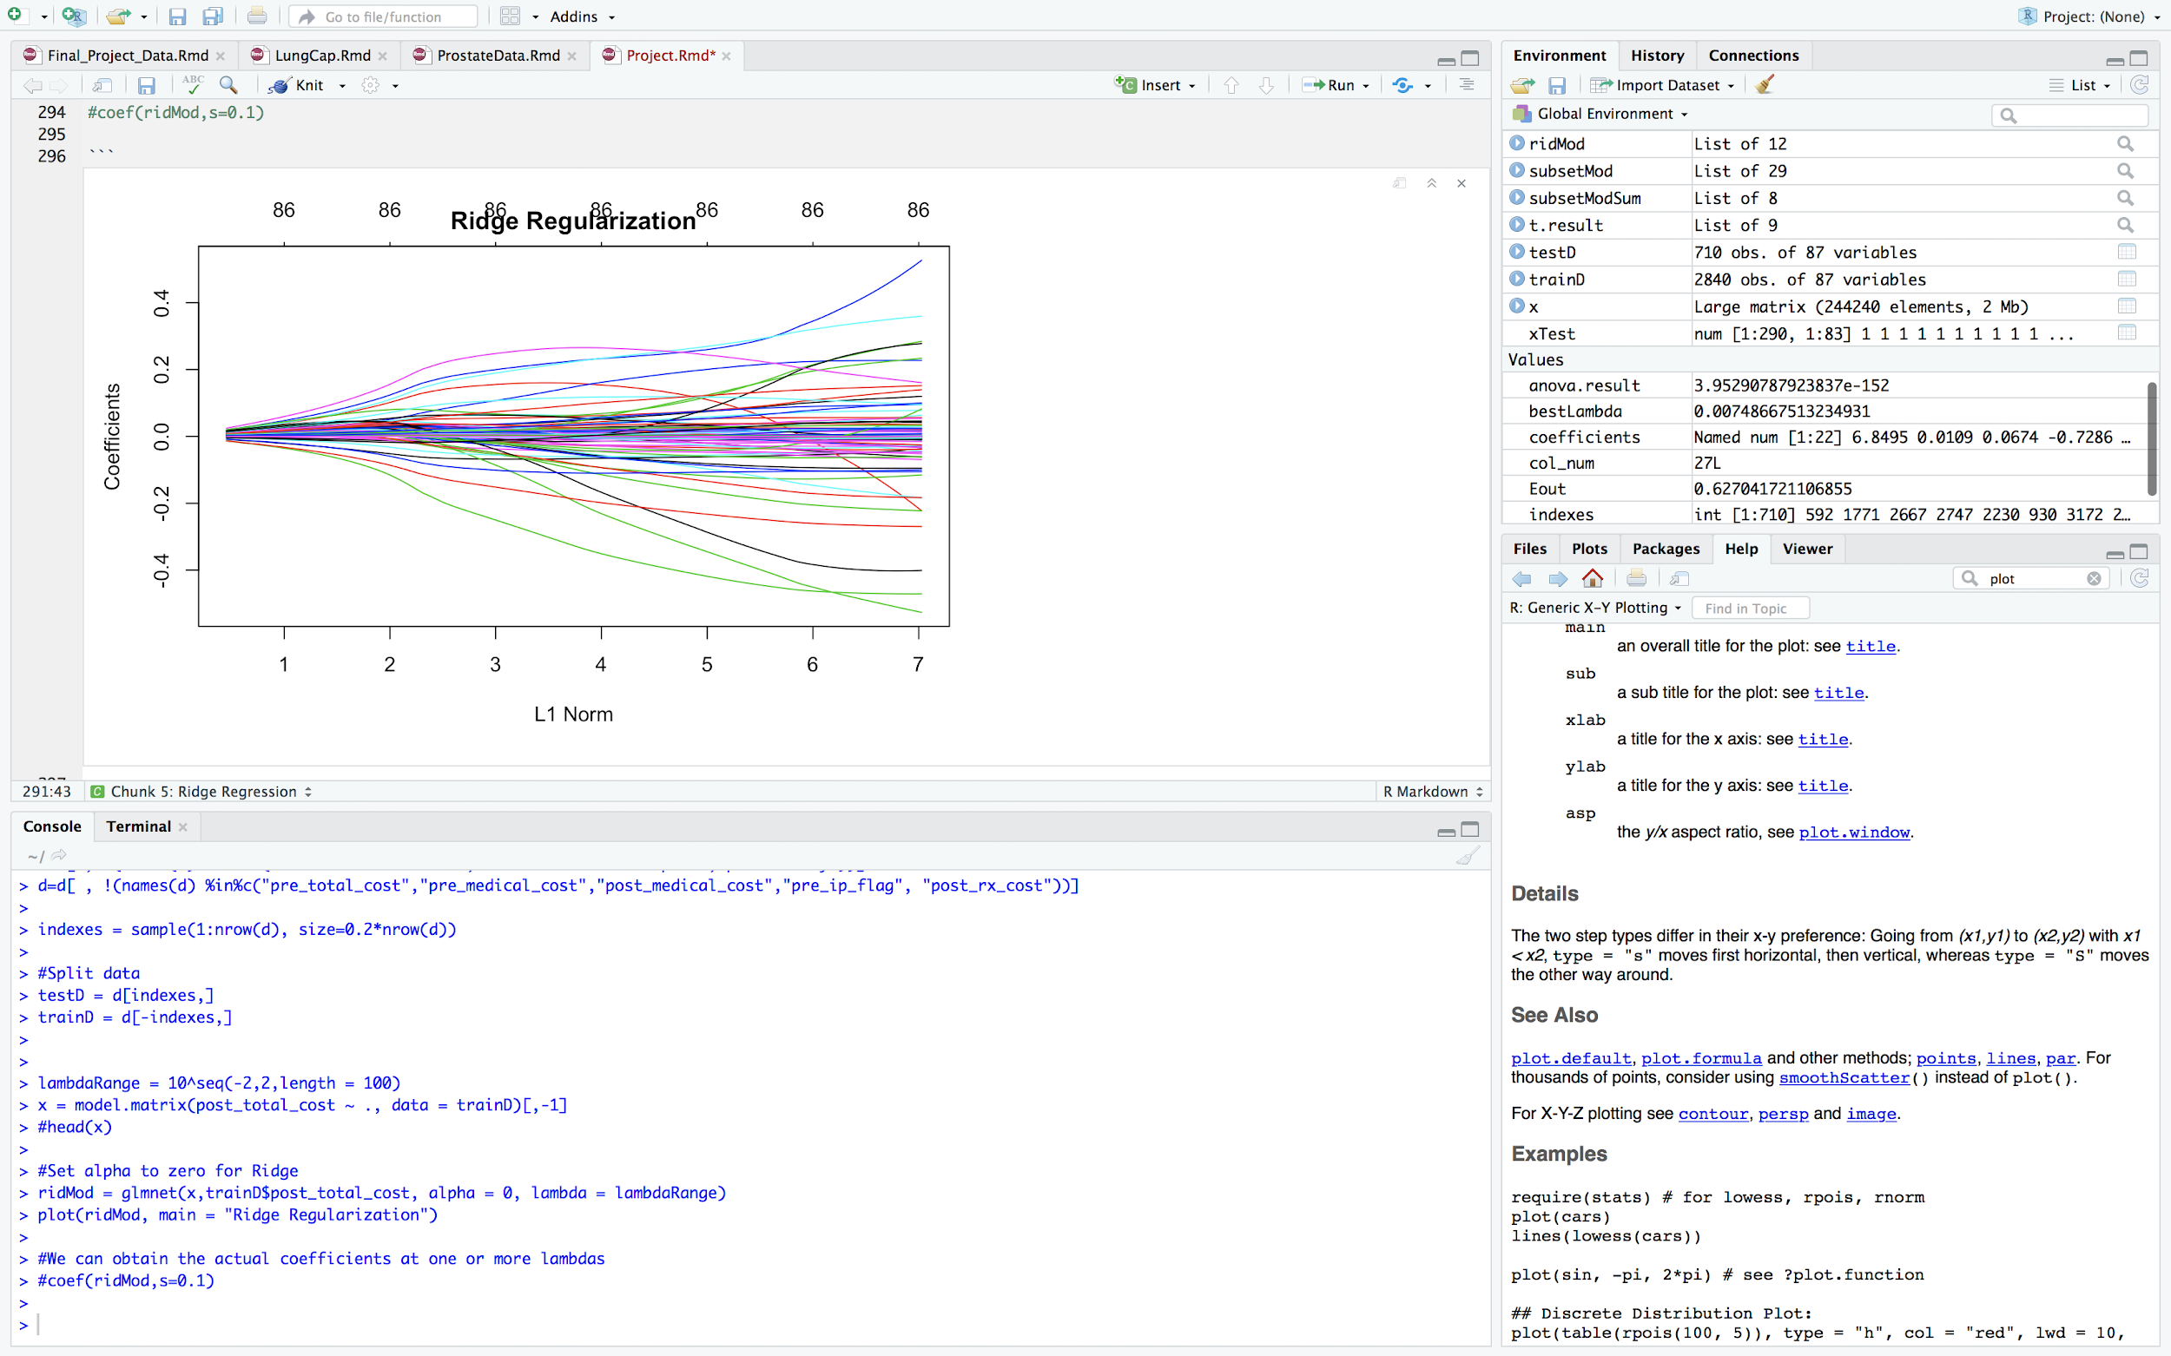
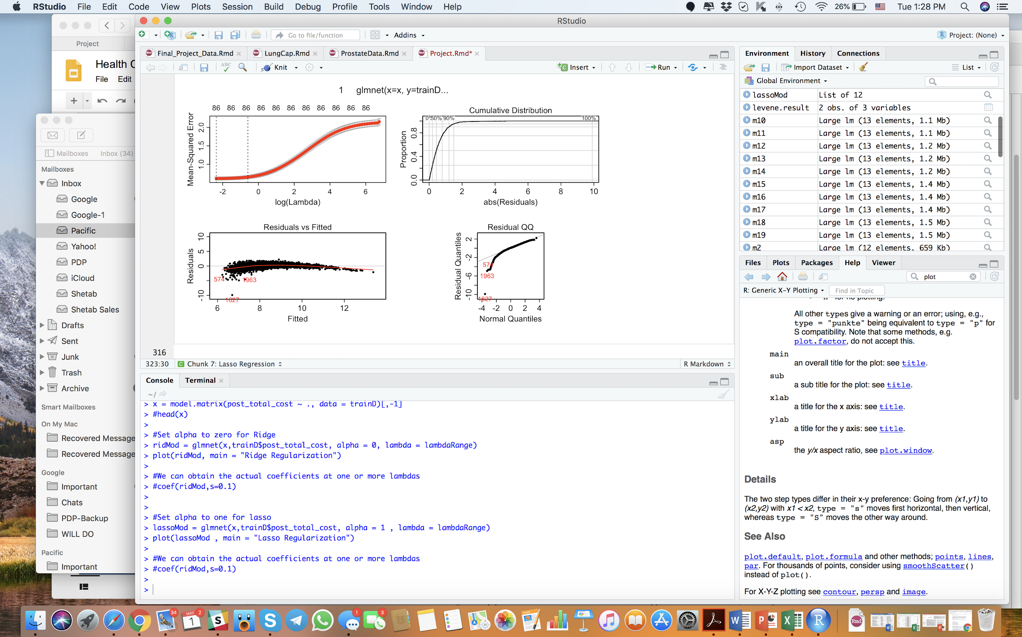
Ridge Regression:
Usage of log of dependent variable
The best lambda is 0.93
A lot of coefficients are near to 0.
Out of sample error is 0.61
There is some deterministic part in Residuals that need to be removed.

Slide 14
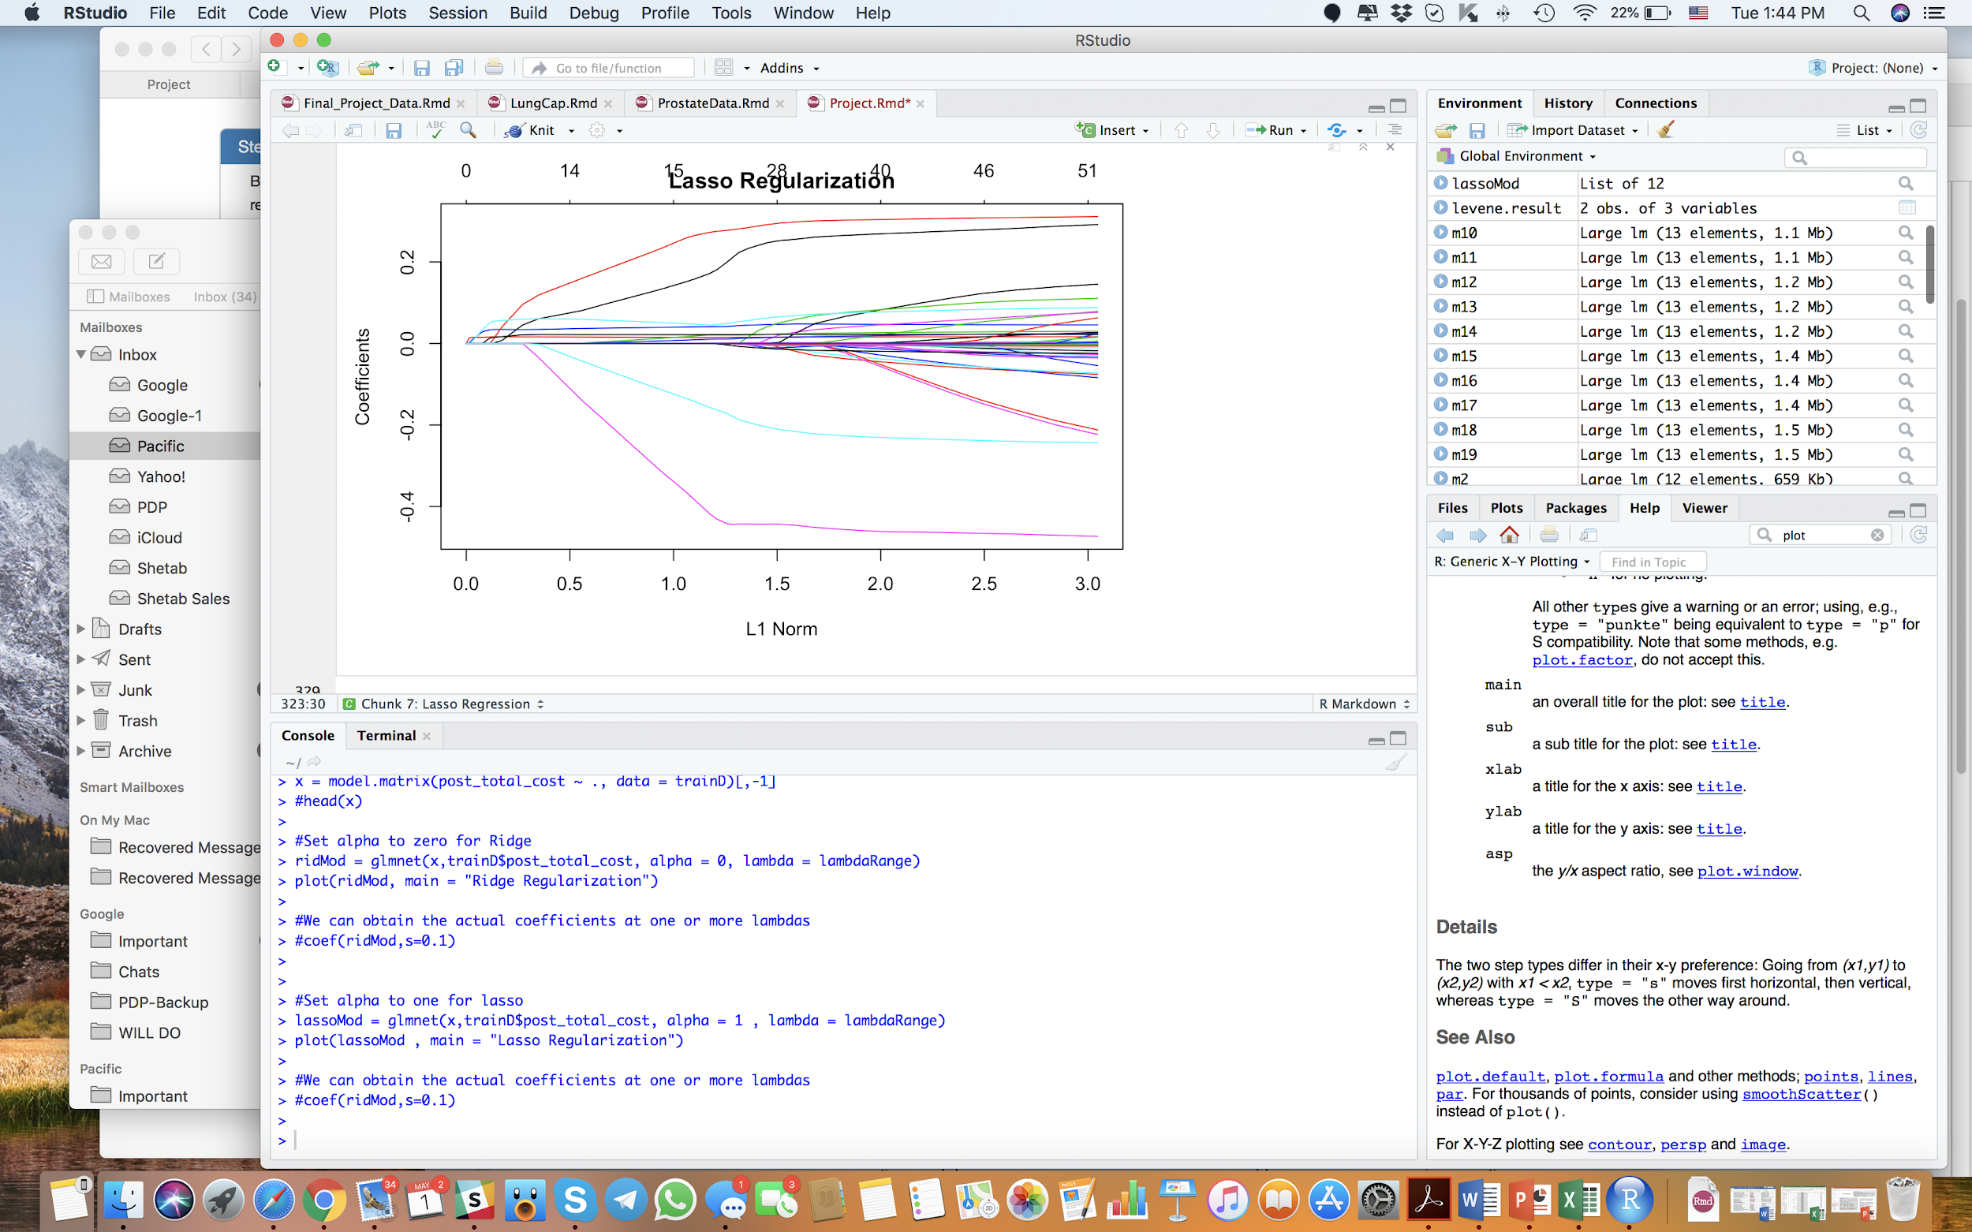
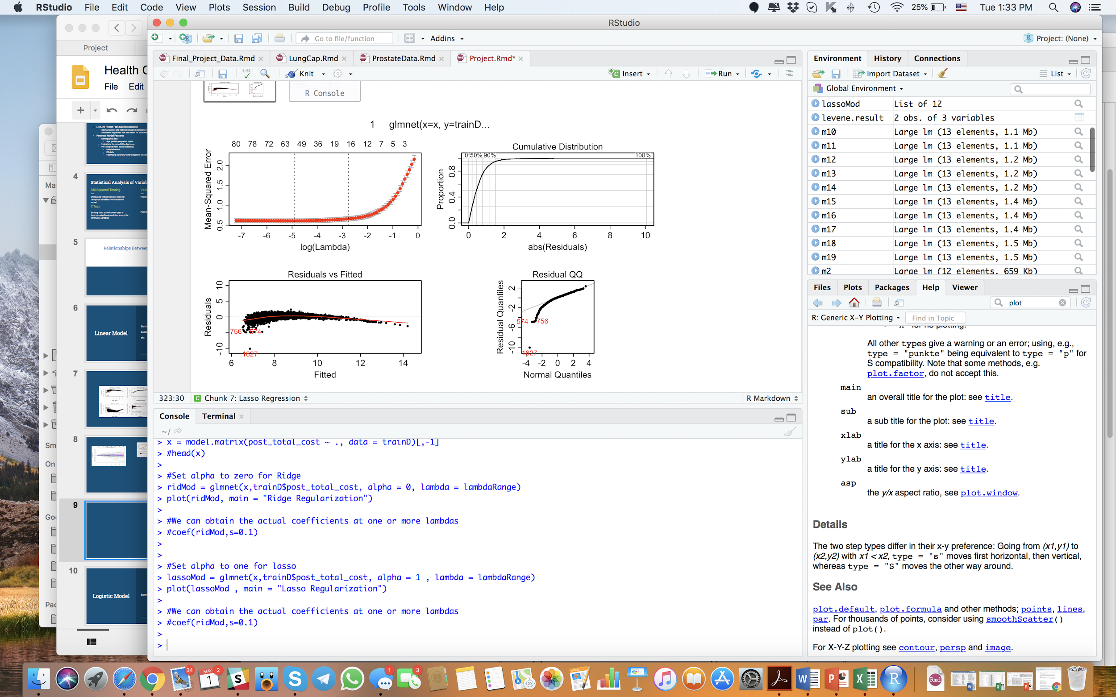
Lasso Regression:
Usage of log of dependent variable same to Ridge
The best lambda is 0.008
53 coefficients
Out of sample error is 0.61
Lasso outperforms all.

Slide 15
Future works:
Making an stochastic residual chart.
Finding better model by K-fold cross validation
Embedding more variables from Analytic file to make a descent model

Slide 16
Logistic Model
Exploratory Analysis
Model Selection
Logistic Regression by Ridge
Logistic Regression by Lasso

Slide 17
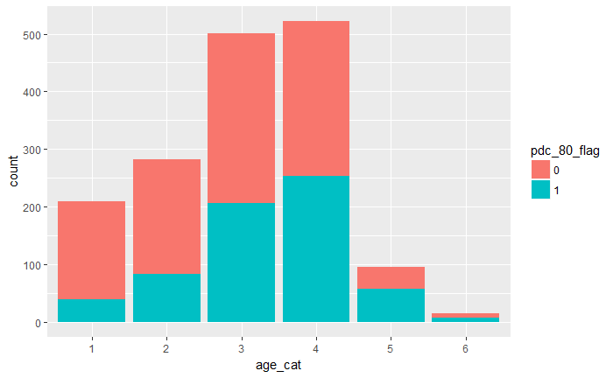
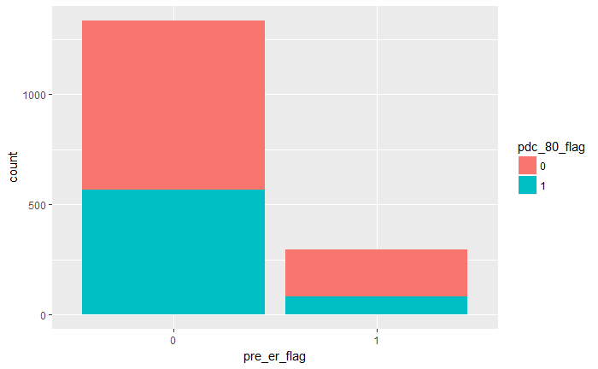
Visualization/Exploratory Analysis
Older patients seem to have higher adherence
Older patients seem to have higher adherence
Patients with more than one ER visit pre-index actually show lower adherence

Slide 18
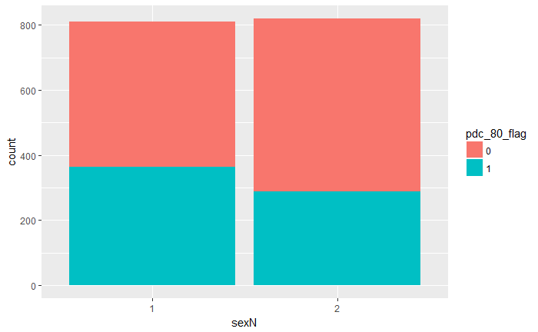
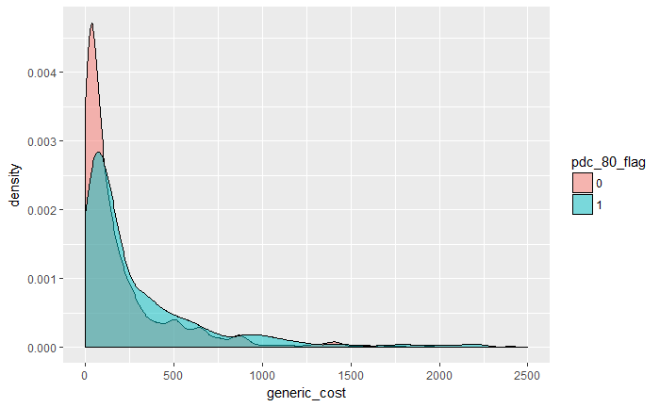
Visualization/Exploratory Analysis
Female patience are slightly less adherent
We don’t find much separation between the classes by cost of scripts filled pre-index

Slide 19
Model Fitting
Data Preprocessing
Removed NA values since glmnet package doesn’t handle them
Removed other adherence variables, ‘pdc’ and ‘pdc_cat’
Removed factor variables with highly imbalanced classes (primarily the comorbidity features
Filtered on diabetic patients

Slide 20
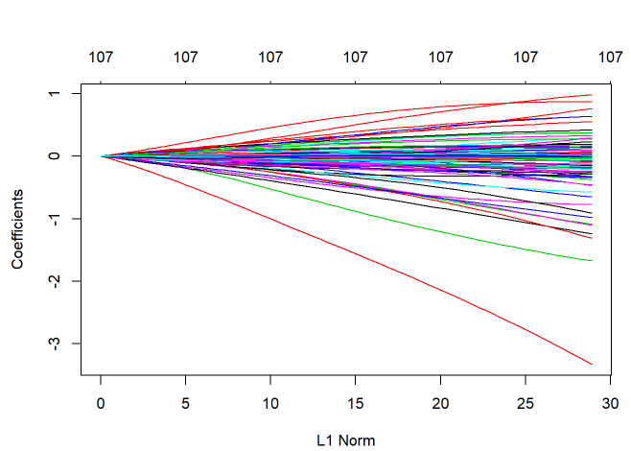
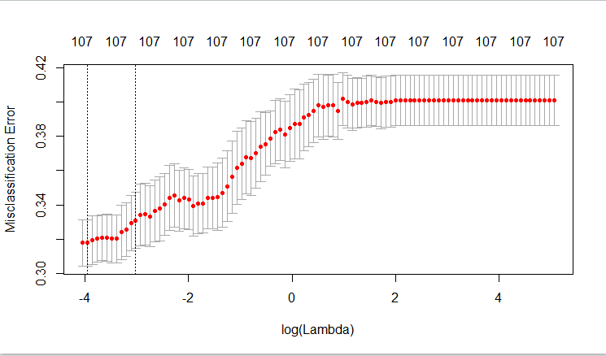
Model Fitting
Ridge Regression
By cross-validation, best value for lambda is about 0.034
As expected, every variable in the model has a non-zero coefficient
Overall prediction accuracy on the test set is about 72%

Slide 21
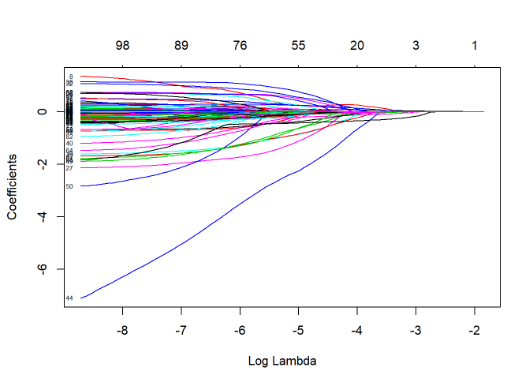
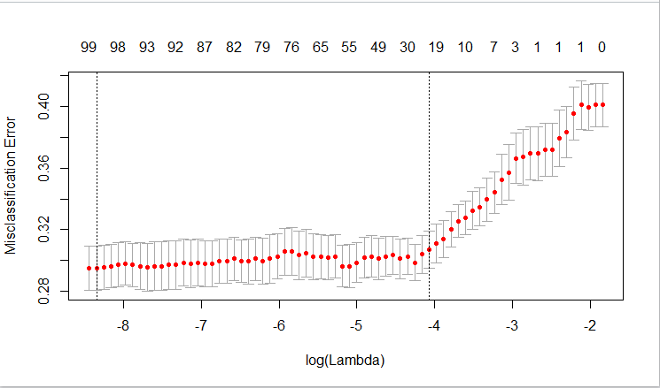
Model Fitting
Lasso Regression
By cross-validation, best value for lambda is about 0.0098
About half of the features have non-zero coefficients
Still includes about 40 variables
Overall prediction accuracy on the test set is about 70%

Slide 22
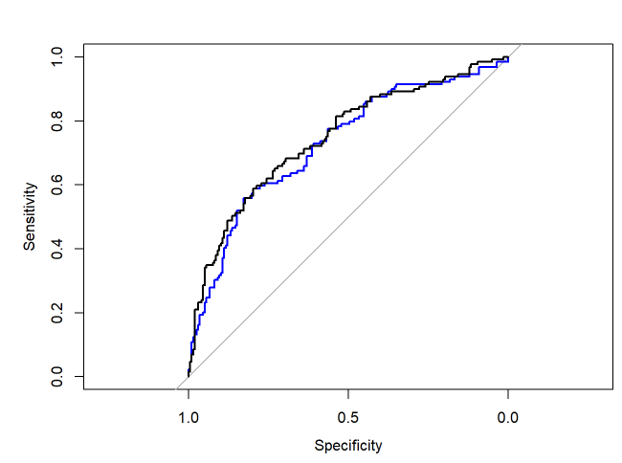
Model Comparison
ROC curve for ridge shown in blue, lasso in black
Despite slightly higher overall classification score, lasso model has higher ROC AUC score (0.75 vs 0.73)
Lasso is also the more sparse model, so favor this one

Slide 23
Questions

